Slide 1
Excel presentation

Slide 2
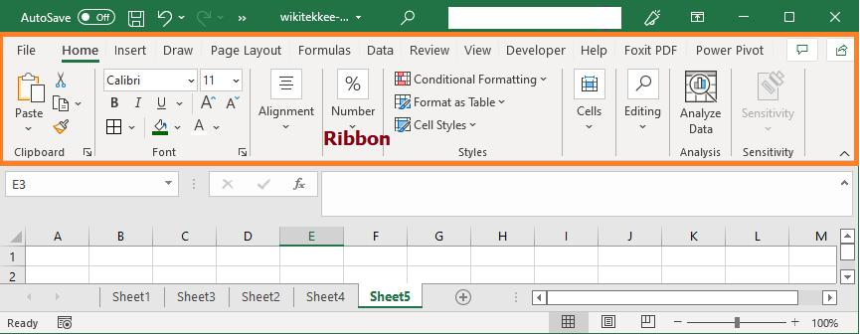
Ribbon
The Ribbon is the horizontal menu located at the top of the Excel window. It contains all the tools and commands needed to create and edit worksheets.

Slide 3
Tab | Purpose
Home | Formatting, Copy, Paste, Font, Alignment
Insert | Tables, Charts, Pictures, Shapes
Page Layout | Margins, Orientation, Themes
Formulas | Functions and calculations
Data | Sort, Filter, Validation
Review | Spell Check, Comments, Protect Sheet
View | Zoom, Freeze Panes, Window settings

Slide 4
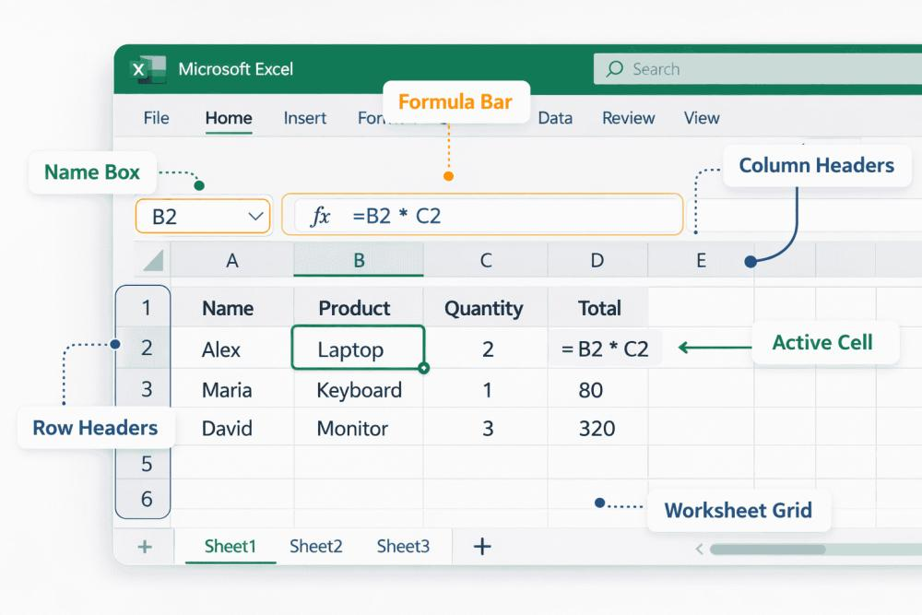
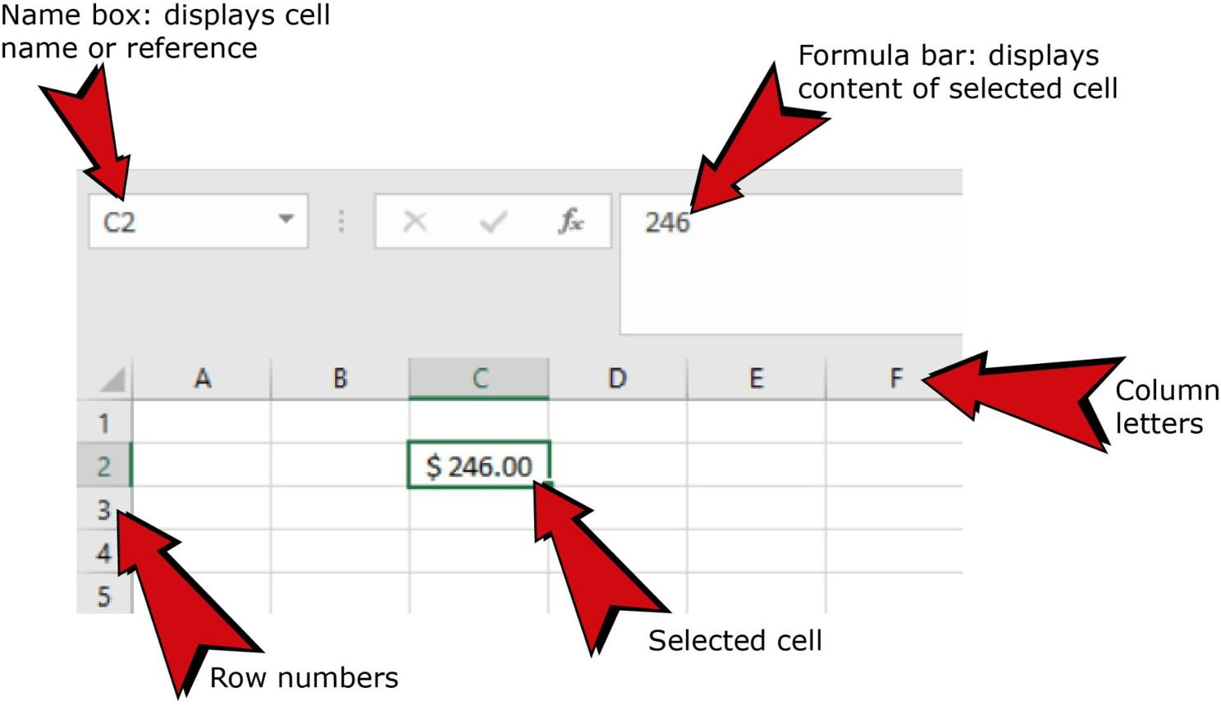
Name Box
The Name Box displays the address of the currently selected cell.

Slide 5
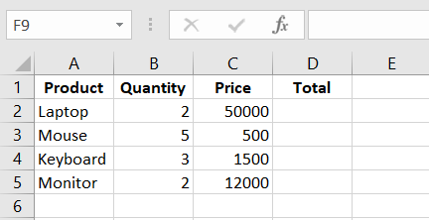
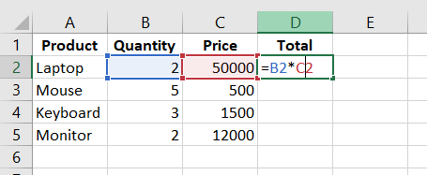
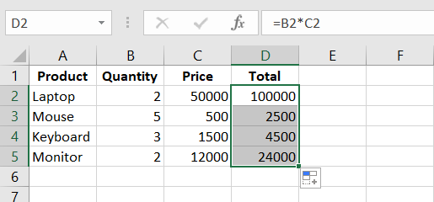
Data stores
Put formula in onw place and drag till below
After drag till below it generated for all row

Slide 6
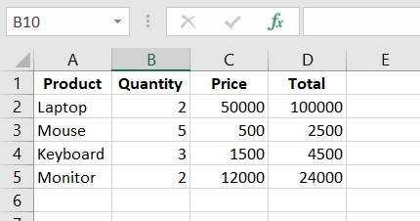
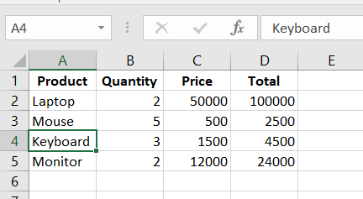
If we type A4 in name box it jumps directly to that place
1St in name box its B10

Slide 7
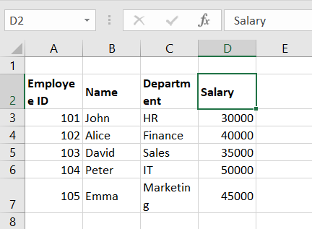
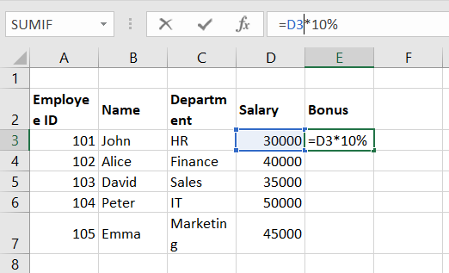
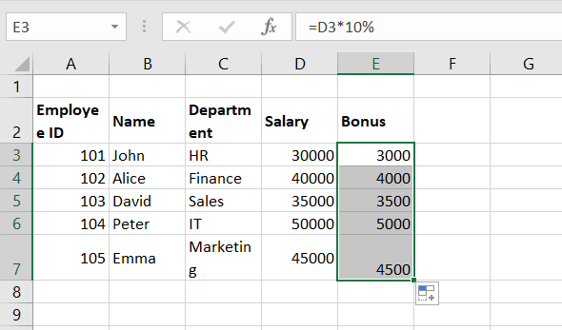
Formula Bar Example
After giving formula
After dragging top to bottom

Slide 8
Logical functions — IF, IFS, AND, OR, NOT, nested IF
Employee ID | Name | Department | Experience | Basic Salary | Attendance | Age | Marks
101 | Raj | HR | 7 | 55000 | Present | 28 | 95
102 | Priya | Finance | 3 | 42000 | Present | 24 | 84
103 | Arun | IT | 10 | 65000 | Absent | 32 | 72
104 | Meena | Sales | 5 | 38000 | Present | 27 | 67
105 | John | HR | 8 | 72000 | Present | 35 | 91
106 | Sara | IT | 2 | 35000 | Absent | 23 | 48
107 | David | Finance | 6 | 50000 | Present | 30 | 76
108 | Anu | Sales | 4 | 45000 | Present | 26 | 58

Slide 9
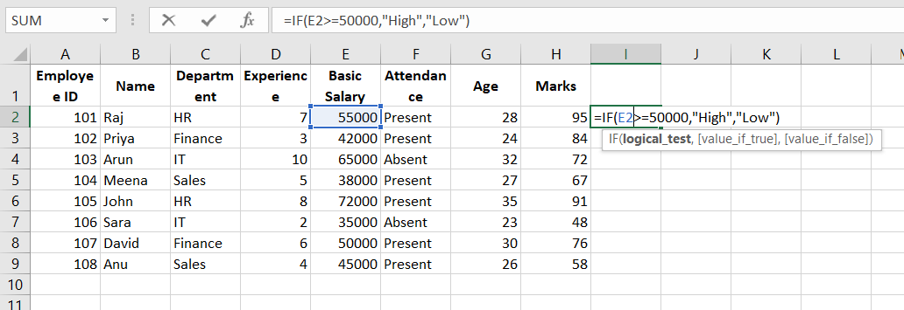
IF Function :
Formula
=IF(E2>=50000,"High","Low")

Slide 10
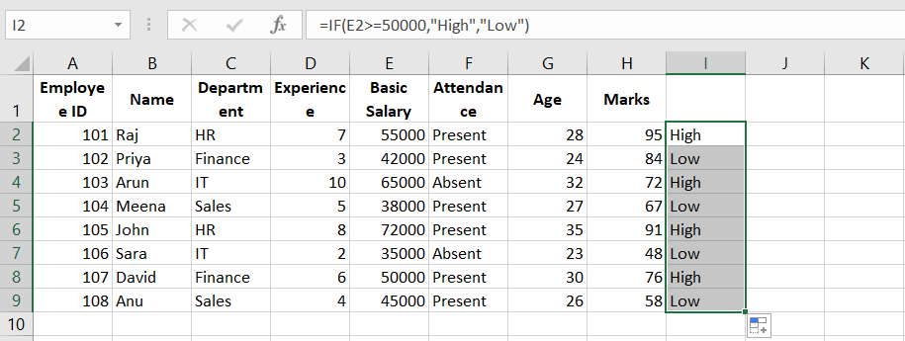
At last after dragging that formula to last it applies for all

Slide 11
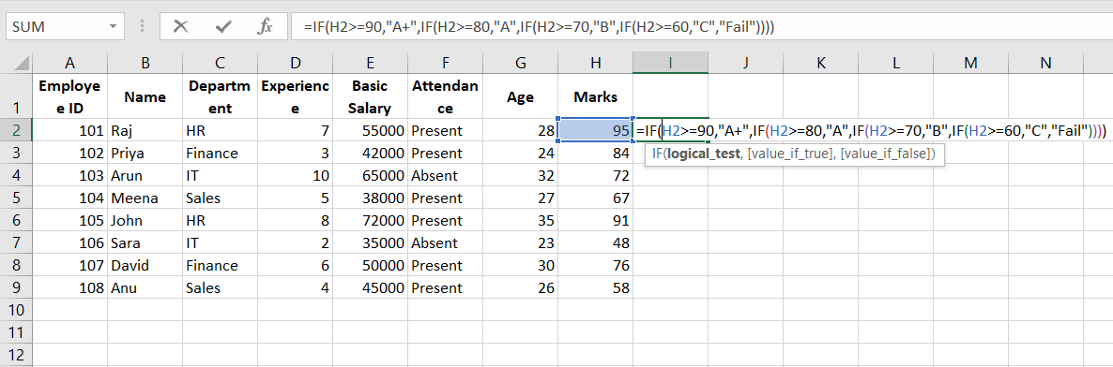
IFS Funcrion:
IFS Formula
=IFS(H2>=90,"A+",H2>=80,"A",H2>=70,"B",H2>=60,"C",TRUE,"Fail")

Slide 12
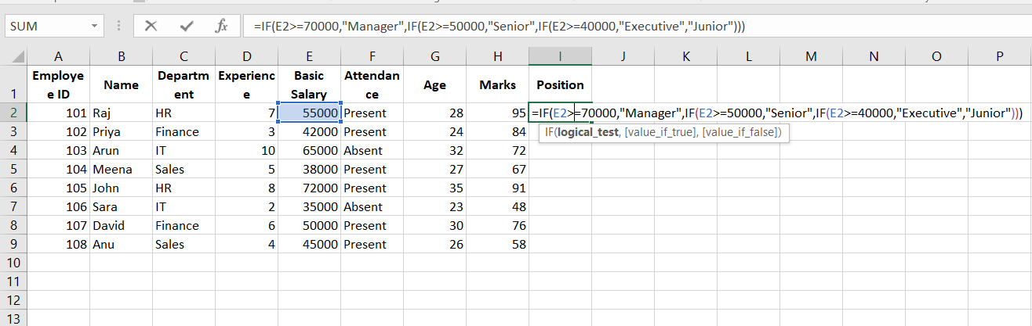
Nested IF :
Formula
=IF(E2>=70000,"Manager",IF(E2>=50000,"Senior",IF(E2>=40000,"Executive","Junior")))

Slide 13
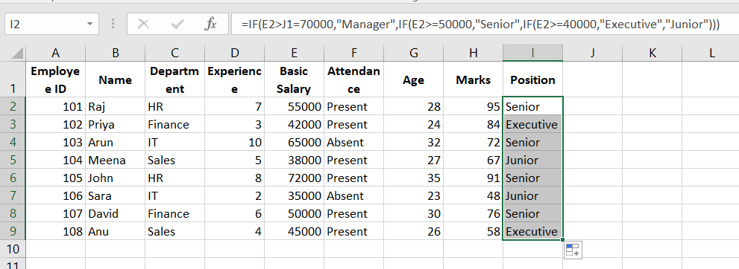
At last after dragging that formula to last it applies for all

Slide 14
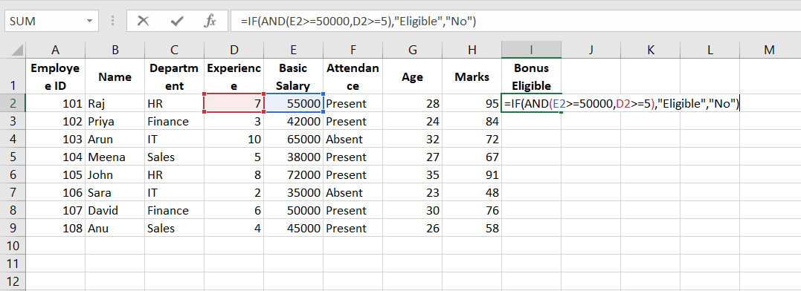
AND Function:
Formula :
=IF(AND(E2>=50000,D2>=5),"Eligible","No")

Slide 15
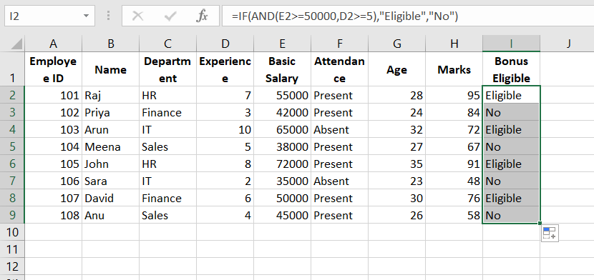
At last after dragging that formula to last it applies for all

Slide 16
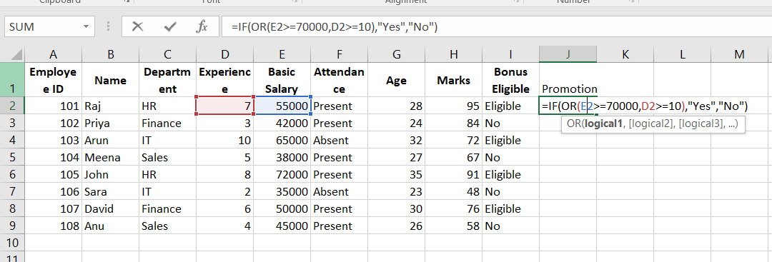
OR Function :
Formula
=IF(OR(E2>=70000,D2>=10),"Yes","No")

Slide 17
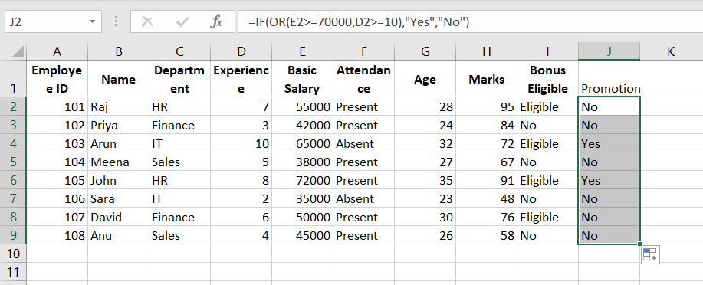
At last after dragging that formula to last it applies for all

Slide 18
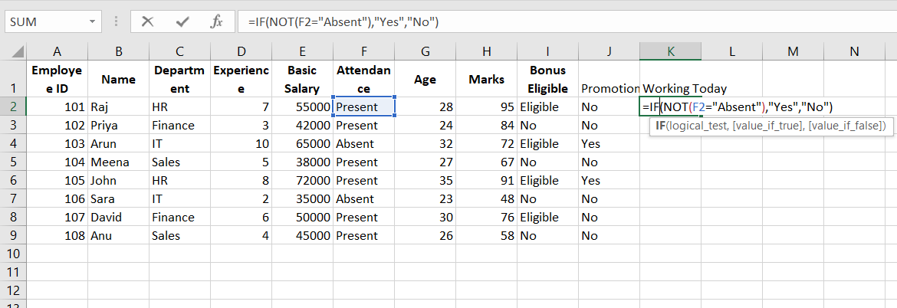
NOT FUNCTION:
Formula
=IF(NOT(F2="Absent"),"Yes","No")

Slide 19
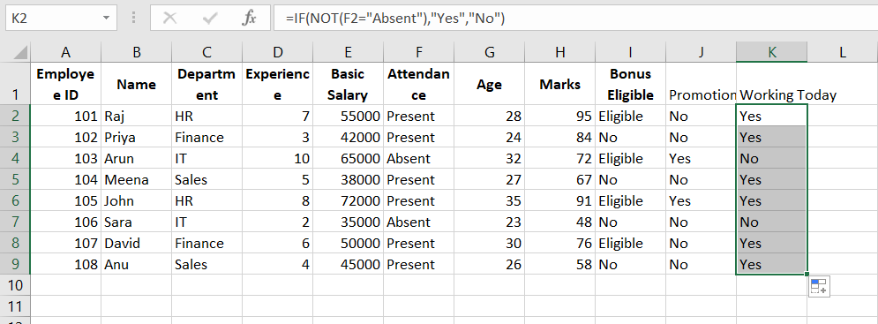
At last after dragging that formula to last it applies for all

Slide 20
Lookup functions — VLOOKUP, HLOOKUP, INDEX-MATCH, XLOOKUP
A | B | C | D | E
Employee ID | Name | Department | Salary | Experience
101 | Raj | HR | 55000 | 7
102 | Priya | Finance | 42000 | 3
103 | Arun | IT | 65000 | 10
104 | Meena | Sales | 38000 | 5
105 | John | HR | 72000 | 8
106 | Sara | IT | 35000 | 2
107 | David | Finance | 50000 | 6
108 | Anu | Sales | 45000 | 4

Slide 21
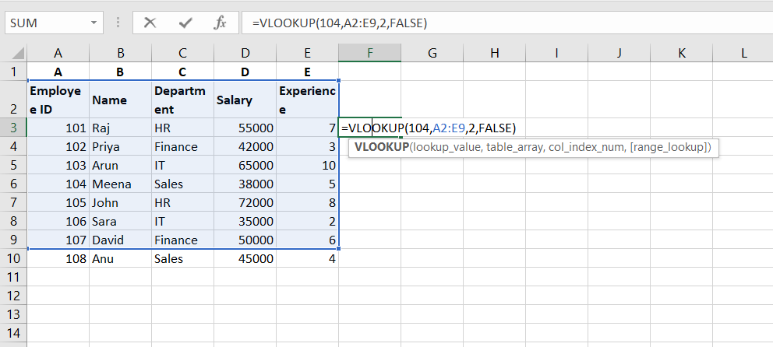
VLOOKUP :
Formula
=VLOOKUP(104,A2:E9,2,FALSE)

Slide 22
Syntax
=VLOOKUP(lookup_value, table_array, column_number, FALSE)
Result
Meena
Explanation
Search 104
↓
Found in first column
↓
Return column 2 (Name)

Slide 23
HLOOKUP (Horizontal Lookup)
Arrange the data like this
 | B | C | D | E
1 | ID | 101 | 102 | 103
2 | Name | Raj | Priya | Arun
3 | Salary | 55000 | 42000 | 65000

Slide 24
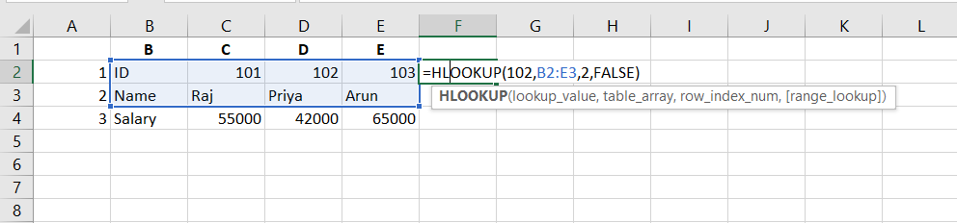
HLOOKUP :
Find Name of ID 102
=HLOOKUP(102,B1:E3,2,FALSE)

Slide 25
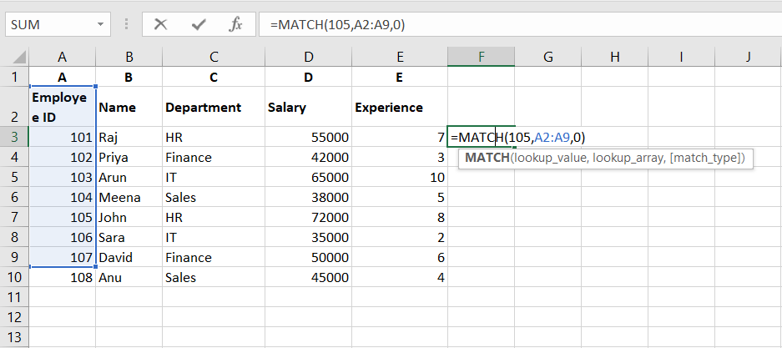
INDEX + MATCH :
MATCH
=MATCH(105,A2:A9,0)
Result
6

Slide 26
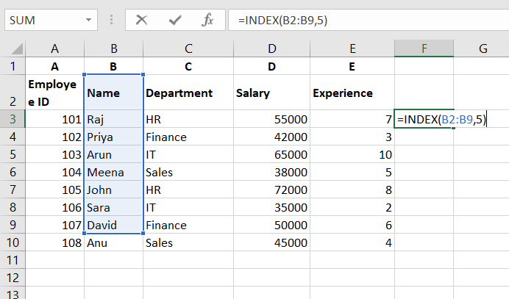
MATCH :
INDEX
=INDEX(B2:B9,5)
Result
John

Slide 27
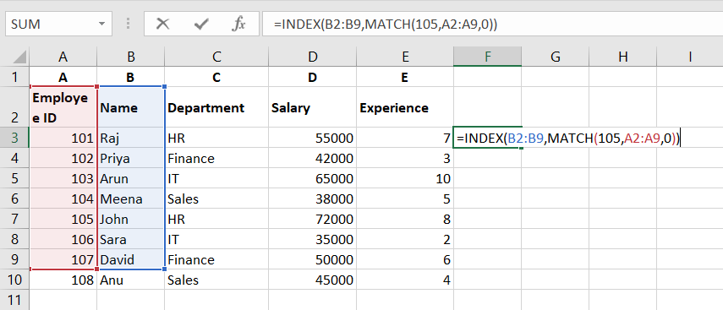
Combine Both :
Find Name of Employee ID 105
=INDEX(B2:B9,MATCH(105,A2:A9,0))
Result
John

Slide 28
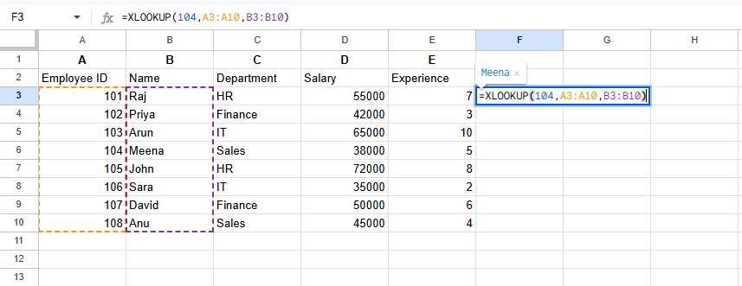
XLOOKUP (Excel 365 / Excel 2021)
Find Name
=XLOOKUP(104,A2:A9,B2:B9)
Result
Meena

Slide 29
Find Salary
=XLOOKUP(107,A2:A9,D2:D9)
Result
50000

Slide 30
Comparison Table :
Feature | VLOOKUP | HLOOKUP | INDEX-MATCH | XLOOKUP
Search Direction | Vertical | Horizontal | Any | Any
Searches Left | No | No | Yes | Yes
Searches Right | Yes | Yes | Yes | Yes
Need Column Number | Yes | Need Row Number | No | No
Returns Custom Message if Not Found | No | No | No | Yes
Available In | All Excel Versions | All Excel Versions | All Excel Versions | Excel 365 / Excel 2021

